Slide 1
Chapter 7: Deadlocks

Slide 2
Chapter 7: Deadlocks
The Deadlock Problem
System Model
Deadlock Characterization
Methods for Handling Deadlocks
Deadlock Prevention
Deadlock Avoidance
Deadlock Detection
Recovery from Deadlock

Slide 3
Chapter Objectives
To develop a description of deadlocks, which prevent sets of concurrent processes from completing their tasks
To present a number of different methods for preventing or avoiding deadlocks in a computer system

Slide 4
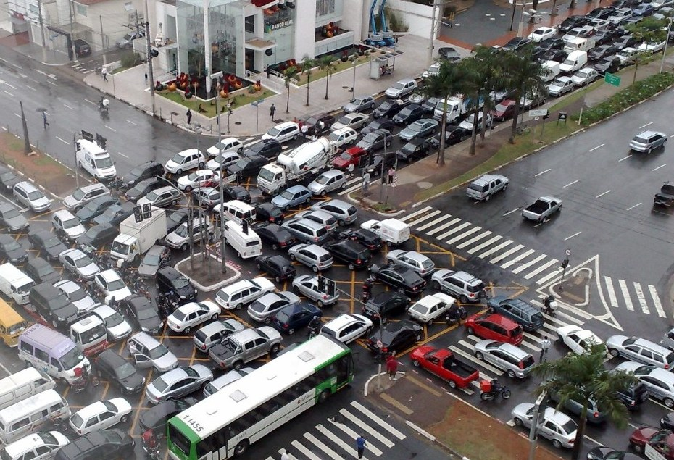
The Deadlock Problem

Slide 5
The Deadlock Problem
A set of blocked processes each holding a resource and waiting to acquire a resource held by another process in the set.
The resources may be either physical resources or logical resources.
Notes:
logical resource?

Slide 6
The Deadlock Problem
Example
  System has 2 disk drives
  P₁ and P₂ each hold one disk drive and each needs another one
Example
  semaphores A and B, initialized to 1
        P₀ P₁
        wait (A); wait(B)
        wait (B); wait(A)

Slide 7
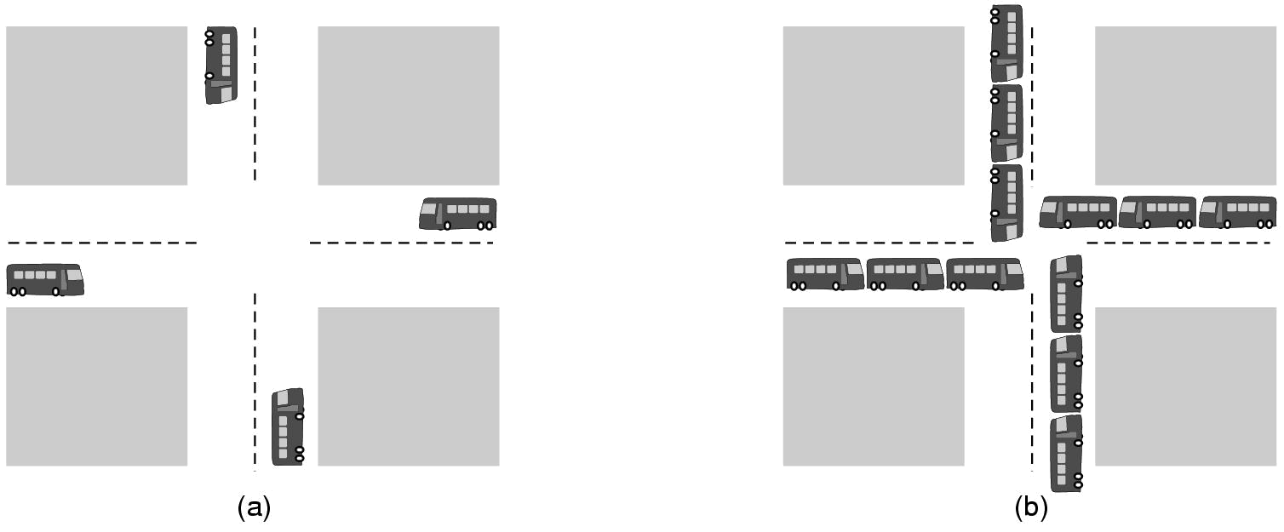
Deadlock Example
deadlock
(a) A potential deadlock (b) an actual deadlock

Slide 8
Why Deadlock?
Resource competition
  The number of resources is not sufficient for processes requirements
Advance order of Concurrent processes is not appropriate
  In a multiprogramming system, it is asynchronous for concurrent processes execution
  In some order, each process can complete successfully
  In some order, there will be a deadlock

Slide 9
Concurrent processes P1,P2; resources R1 and R2 has only one instance respectively
Curve4 will lead to unsafe area
②
P₂Rel(R₁)
P₂Rel(R₂)
③
P₂Req(R₁)
②
③
①
P₂Req(R₂)
④
③
③
①
P₁Req(R₁)
P₁Req(R₂)
P₁Rel(R₁)
P₁Rel(R₂)
Notes:
??

Slide 10
System Model
Resource types R₁, R₂, . . ., R_{m}
    CPU cycles, memory space, I/O devices
Each resource type R_{i} has W_{i} instances.
The number of resources requested may not exceed the total number of resources available in the system.

Slide 11
How process utilizes a resource?
Each process utilizes a resource as follows:
  request
  use
  Release
The request and release are system calls, such as open() and close() file, and allocate() and free() memory system calls.

Slide 12
Necessary Conditions for Deadlock
Deadlock can arise if four conditions hold simultaneously.
Mutual exclusion: only one process at a time can use a resource
Hold and wait: a process holding at least one resource is waiting to acquire additional resources held by other processes
No preemption: a resource can be released only voluntarily by the process holding it, after that process has completed its task

Slide 13
Necessary Conditions for Deadlock(Cont)
Circular wait: there exists a set {P₀, P₁, …, P₀} of waiting processes such that P₀ is waiting for a resource that is held by P₁, P₁ is waiting for a resource that is held by
P₂, …, P_{n–1} is waiting for a resource that is held by
P_{n}, and P_{n} is waiting for a resource that is held by P₀.
Process A
Resource A
Resource B
Process B

Slide 14
Resource-Allocation Graph
A set of vertices V and a set of edges E.
V is partitioned into two types:
  P = {P₁, P₂, …, P_{n}}, the set consisting of all the processes in the system
  R = {R₁, R₂, …, R_{m}}, the set consisting of all resource types in the system
request edge – directed edge P₁ → R_{j}
assignment edge – directed edge R_{j} → P_{i}

Slide 15
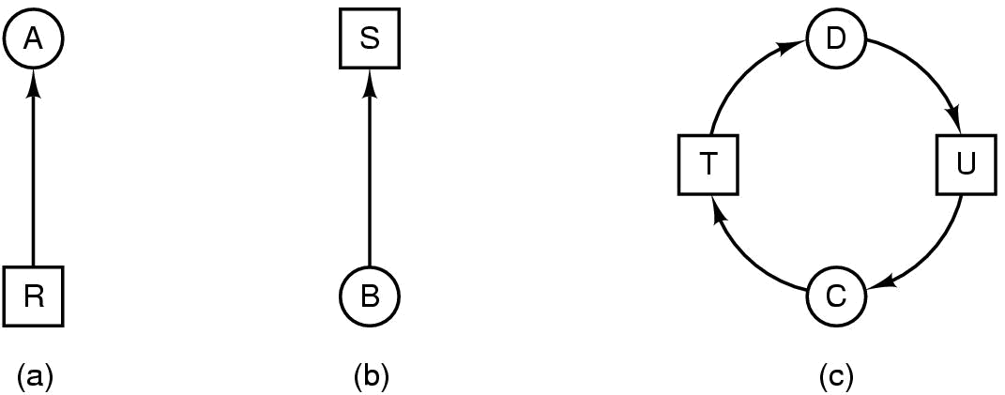
Resource-Allocation Graph
Resource R assigned to process A
Process B is requesting/waiting for resource S
Process C and D are in deadlock over resources T and U

Slide 16
Resource-Allocation Graph (Cont.)
Process
Resource Type with 4 instances
P_{i} requests instance of R_{j}
P_{i} is holding an instance of R_{j}
P_{i}
R_{j}
P_{i}
R_{j}

Slide 17

Example of a Resource Allocation Graph

Slide 18

Resource Allocation Graph With A Deadlock
Notes:
没有环就没有死锁，是否打破死锁四个条件？

Slide 19

Graph With A Cycle But No Deadlock

Slide 20
Basic Facts
If graph contains no cycles ⇒ no deadlock
If graph contains a cycle ⇒
  if only one instance per resource type, then deadlock
  if several instances per resource type, possibility of deadlock

Slide 21
Methods for Handling Deadlocks
Ensure that the system will never enter a deadlock state
  Deadlock prevention
  Deadlock avoidance
Allow the system to enter a deadlock state and then recover
  Deadlock detection and recovery
Ignore the problem and pretend that deadlocks never occur in the system; used by most operating systems, including UNIX
  Ostrich policy

Slide 22
Deadlock Prevention
Restrain the ways request can be made, so that at least one of the necessary conditions for deadlock can not occur.
Possible side effects:
  Low device utilization
  Reduced system throughput
Mutual Exclusion
  not required for sharable resources; must hold for nonsharable resources.
Notes:
抑制死锁发生的必要条件

Slide 23
Deadlock Prevention
Hold and Wait – must guarantee that whenever a process requests a resource, it does not hold any other resources
  Require process to request and be allocated all its resources before it begins execution
  or allow process to request resources only when the process has none
  Low resource utilization; starvation possible

Slide 24







Dining Philosophers
5 philosophers sitting around a round table
1 chopstick in between each pair of philosophers
  5 chopsticks total
Each philosopher needs two chopsticks to eat
How to prevent deadlock

Slide 25
Deadlock Prevention (Cont.)
No Preemption –
  If a process that is holding some resources requests another resource that cannot be immediately allocated to it, then all resources currently being held are released
  Preempted resources are added to the list of resources for which the process is waiting
  Process will be restarted only when it can regain its old resources, as well as the new ones that it is requesting
Notes:
规定:
如果一个进程新的资源申请没有满足，它要释放占有的所有资源
这些被抢占的资源放入进程等待资源列表中,
这个进程只有能够重新得到原有的资源，并且它所申请的新资源也可得到时,才能重新开始

Slide 26
Deadlock Prevention (Cont.)
No Preemption –
  When process A requests some unavailable resources, we check whether they are allocated to another process B that is waiting for other resources;
  If so, we preempt the desired resources from B and allocate them to A.
  Otherwise, A must wait.
Notes:
（非抢占）另外一种解决方案:
当进程A提出资源申请时, 首先检查这些资源是否可用
是,则分配之,否则检查这些资源是否已分配给了另外的进程(而这个进程又在等待其他的资源)
如果存在这样的进程B,从进程B剥夺进程A所需的资源分配给进程A使用.相反, 则进程A等待
当进程A在等待的过程中,它所持有资源可能会被剥夺分配给其他的进程.这样,进程A只有得到了它正在申请有资源以及等待过程中被剥夺的资源后,才能恢复运行.

Slide 27
Deadlock Prevention (Cont.)
Allow Preemption!
Can preempt CPU by
  saving its state to thread control block and resuming later
Can preempt memory by
  swapping memory out to disk and loading it back later
Can we preempt the holding of a lock?

Slide 28
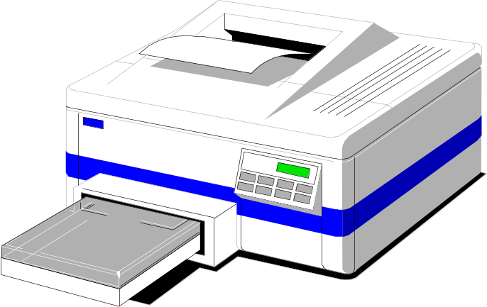
Deadlock Prevention (Cont.)
Some resource cannot be preempted
Consider a process given the printer
  halfway through its job
  now forcibly take away printer
  !!??

Slide 29
Deadlock Prevention (Cont.)
Circular Wait
  impose a total ordering of all resource types, and require that each process requests resources in an increasing order of enumeration

Slide 30
Deadlock Avoidance
Requires that the system has some additional a priori information available. E.g, which type resources a process needs? How many instances of each resource type a process needs at most?
Simplest and most useful model requires that each process declare the maximum number of resources of each type that it may need

Slide 31
Deadlock Avoidance
The deadlock-avoidance algorithm dynamically examines the resource-allocation state to ensure that there can never be a circular-wait condition
Resource-allocation state is defined by the number of available and allocated resources, and the maximum demands of the processes
When a process requests an available resource, system must decide if immediate allocation leaves the system in a safe state.
Notes:
允许进程动态地申请资源，系统在进行资源分配之前，先计算资源分配的安全性:
安全:分配资源给进程
不安全:进程等待

Slide 32
Safe State
System is in safe state if there exists a sequence <P₁, P₂, …, P_{n}> of ALL the processes is the systems such that for each P_{i}, the resources that P_{i} can still request can be satisfied by currently available resources + resources held by all the P_{j}, with j < i
That is:
  If P_{i} resource needs are not immediately available, then P_{i} can wait until all P_{j} have finished
  When P_{j} is finished, P_{i} can obtain needed resources, execute, return allocated resources, and terminate
  When P_{i} terminates, P_{i +1} can obtain its needed resources, and so on

Slide 33
example
processes:P₁、P₂ and P_{3.} 12 tapes. Snapshot at T₀ :
    process max allocated need available
    P₁ 10 5 5 3
    P₂ 4 2 2
    P₃ 9 2 7
sequence（P₂、P₁、P₃）satisfies the safety condition：
  Allocate 2 of the 3 available tapes to P₂，which satisfies the max need of P_{2.} when P₂ finishes, the system will have 5 available tapes.
  Then allocate the 5 tapes to P₁.when P₁ finishes, the system will have 10 available tapes.
  At last, allocate 7 of the 10 tapes to P₃
  So, system is safe at T_{0.}

Slide 34
System goes from a safe state to an unsafe state
Suppose that, at T_{0,} P₃ requests a tape and is allocated one tape. Then system goes from T₀ to T_{1.}
    Process max allocated need available available
before allocating after releasing
P₁ 10 5 5 >
P₂ 4 2 2 =< 2 4
P₃ 9 3 6 >
At T_{1,} we can not find a sequence satisfying safety condition, so, it is unsafe.
Therefore, when P₃ requests a tape at T_{0,} we must make it wait to avoid deadlock.

Slide 35
Basic Facts
If a system is in safe state ⇒ no deadlocks
If a system is in unsafe state ⇒ possibility of deadlock
Avoidance ⇒ ensure that a system will never enter an unsafe state.

Slide 36

Safe, Unsafe , Deadlock State
Notes:
安全态与非安全态的区分

Slide 37
Avoidance algorithms
Single instance of a resource type
  Use a resource-allocation graph
Multiple instances of a resource type
  Use the banker’s algorithm

Slide 38
Resource-Allocation Graph Scheme
Claim edge P_{i} → R_{j} indicated that process P_{j} may request resource R_{j}; represented by a dashed line
Claim edge converts to request edge when a process requests a resource
Request edge converted to an assignment edge when the resource is allocated to the process
When a resource is released by a process, assignment edge reconverts to a claim edge
Resources must be claimed a priori in the system

Slide 39
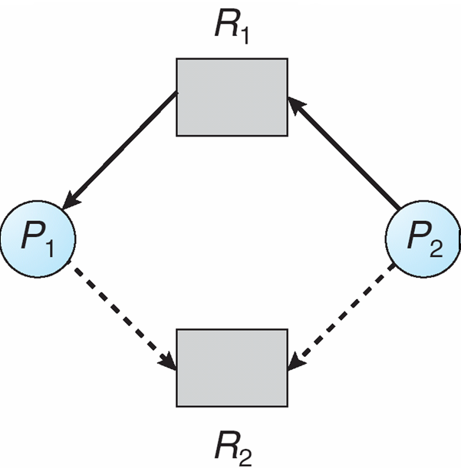
Resource-Allocation Graph

Slide 40
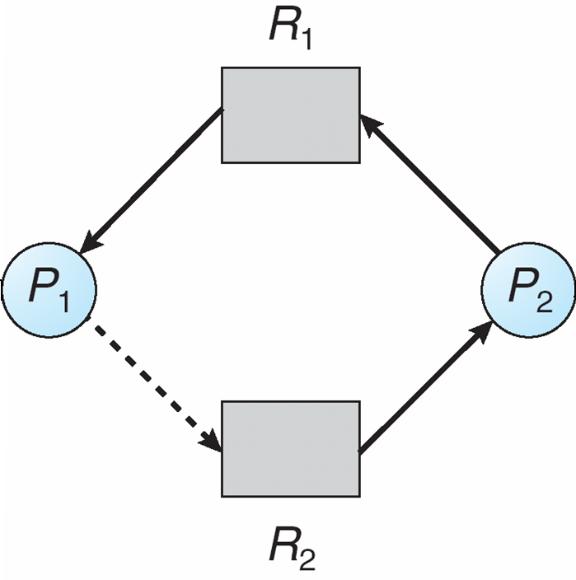
Unsafe State In Resource-Allocation Graph

Slide 41
Resource-Allocation Graph Algorithm
Suppose that process P_{i} requests a resource R_{j}
The request can be granted only if converting the request edge to an assignment edge does not result in the formation of a cycle in the resource allocation graph

Slide 42
Banker’s Algorithm
Multiple instances
Each process must claim the maximum number of each resource type it may need
When a process requests a resource it may have to wait
When a process gets all its resources it must return them in a finite amount of time
Notes:
要求每个进程运行前先声明对每种资源的最大需求数

Slide 43
Data Structures for the Banker’s Algorithm
Let n = number of processes,
m = number of resources types.
Available: Vector of length m. If available [j] = k, there are k instances of resource type R_{j} available
Max: n x m matrix. If Max [i,j] = k, then process P_{i} may request at most k instances of resource type R_{j}
Allocation: n x m matrix. If Allocation[i,j] = k then P_{i} is currently allocated k instances of R_{j}
Need: n x m matrix. If Need[i,j] = k, then P_{i} may need k more instances of R_{j} to complete its task
    Need [i,j] = Max[i,j] – Allocation [i,j]

Slide 44
Safety Algorithm
1. Let Work and Finish be vectors of length m and n, respectively. Initialize:
      Work = Available
      Finish [i] = false for i = 0, 1, …, n- 1
2. Find an i such that both:
  (a) Finish [i] = false
  (b) Need_{i} ≤ Work
  If no such i exists, go to step 4
3. Work = Work + Allocation_{i}
Finish[i] = true
go to step 2
4. If Finish [i] == true for all i, then the system is in a safe state

Slide 45
Resource-Request Algorithm for Process P_{i}
Request_{i} = request vector for process P_{i}. If Request_{i} [j] = k then process P_{i} wants k instances of resource type R_{j}
  1. If Request_{i} ≤ Need_{i} go to step 2. Otherwise, raise error condition, since process has exceeded its maximum claim
  2. If Request_{i} ≤ Available, go to step 3. Otherwise P_{i} must wait, since resources are not available
  3. Pretend to allocate requested resources to P_{i} by modifying the state as follows:
      Available = Available – Request;
      Allocation_{i} = Allocation_{i} + Request_{i};
      Need_{i} = Need_{i} – Request_{i};
    If safe ⇒ the resources are allocated to Pi
    If unsafe ⇒ Pi must wait, and the old resource-allocation state is restored

Slide 46
Example of Banker’s Algorithm
5 processes P₀ through P₄;
3 resource types:
A (10 instances), B (5instances), and C (7 instances)
Snapshot at time T₀:
Allocation Max Available
A B C A B C A B C
P₀ 0 1 0 7 5 3 3 3 2
P₁ 2 0 0 3 2 2
P₂ 3 0 2 9 0 2
P₃ 2 1 1 2 2 2
P₄ 0 0 2 4 3 3

Slide 47
Example (Cont.)
The content of the matrix Need is defined to be
Max – Allocation
Need
A B C
P₀ 7 4 3
P₁ 1 2 2
P₂ 6 0 0
P₃ 0 1 1
P₄ 4 3 1

Slide 48
Example (Cont.)
To find a safe sequence using safety algorithm
  Work[]=available=(3,3,2)
  Finish[i]=false (i=0..4)
  Work need allocation finish
  P1 3 3 2 1 2 2 2 0 0 T
  P3 5 3 2 0 1 1 2 1 1 T
  P4 7 4 3 4 3 1 0 0 2 T
  P2 7 4 5 6 0 0 3 0 2 T
  P0 10 4 7 7 4 3 0 1 0 T
The system is in a safe state since the sequence < P₁, P₃, P₄, P₂, P₀> satisfies safety criteria

Slide 49
Example (Cont.)
Usually, there would be more than one safe sequences if the system is in safe state.
  Work[]=available=(3,3,2)
  Finish[i]=false (i=0..4)
  Work need allocation finish
  P3 3 3 2 0 1 1 2 1 1 T
  P4 5 4 3 4 3 1 0 0 2 T
  P1 5 4 5 1 2 2 2 0 0 T
  P2 7 4 5 6 0 0 3 0 2 T
  P0 10 4 7 7 4 3 0 1 0 T
  Safe sequence：（P3，P4，P1，P2，P0）

Slide 50
Example: P₁ Request (1,0,2)
Check that Request ≤ Available (that is, (1,0,2) ≤ (3,3,2) ⇒ true) Allocation Need Available
A B C A B C A B C
P₀ 0 1 0 7 4 3 2 3 0
P₁ 3 0 2 0 2 0
P₂ 3 0 1 6 0 0
P₃ 2 1 1 0 1 1
P₄ 0 0 2 4 3 1
Executing safety algorithm shows that sequence < P₁, P₃, P₄, P₀, P₂> satisfies safety requirement
Can request for (3,3,0) by P₄ be granted?
Can request for (0,2,0) by P₀ be granted?

Slide 51
Deadlock Detection
Allow system to enter deadlock state
Detection algorithm
Recovery scheme

Slide 52
Single Instance of Each Resource Type
Maintain wait-for graph
  Nodes are processes
  P_{i} → P_{j} if P_{i} is waiting for P_{j}
Periodically invoke an algorithm that searches for a cycle in the graph. If there is a cycle, there exists a deadlock
An algorithm to detect a cycle in a graph requires an order of n² operations, where n is the number of vertices in the graph

Slide 53
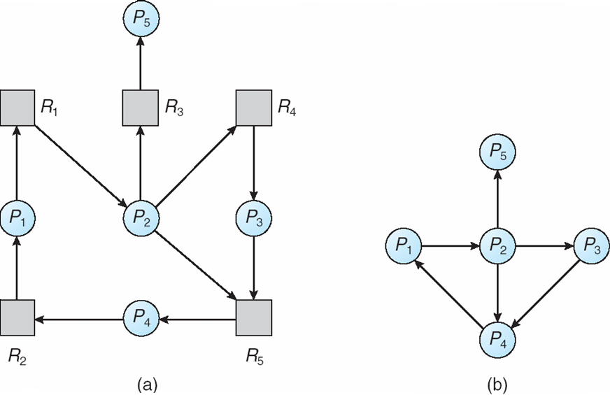
Resource-Allocation Graph and Wait-for Graph
Resource-Allocation Graph
Corresponding wait-for graph

Slide 54
Several Instances of a Resource Type
Available: A vector of length m indicates the number of available resources of each type.
Allocation: An n x m matrix defines the number of resources of each type currently allocated to each process.
Request: An n x m matrix indicates the current request of each process. If Request [i_{j}] = k, then process P_{i} is requesting k more instances of resource type. R_{j}.

Slide 55
Detection Algorithm
1. Let Work and Finish be vectors of length m and n, respectively Initialize:
  (a) Work = Available
  (b) For i = 1,2, …, n, if Allocation_{i} ≠ 0, then
  Finish[i] = false;otherwise, Finish[i] = true
2. Find an index i such that both:
  (a) Finish[i] == false
  (b) Request_{i} ≤ Work
  If no such i exists, go to step 4

Slide 56
Detection Algorithm (Cont.)
3. Work = Work + Allocation_{i}
Finish[i] = true
go to step 2
4. If Finish[i] == false, for some i, 1 ≤ i ≤ n, then the system is in deadlock state. Moreover, if Finish[i] == false, then P_{i} is deadlocked
Algorithm requires an order of O(m x n²⁾ operations to detect whether the system is in deadlocked state

Slide 57
Example of Detection Algorithm
Five processes P₀ through P₄; three resource types
A (7 instances), B (2 instances), and C (6 instances)
Snapshot at time T₀:
Allocation Request Available
A B C A B C A B C
P₀ 0 1 0 0 0 0 0 0 0
P₁ 2 0 0 2 0 2
P₂ 3 0 3 0 0 0
P₃ 2 1 1 1 0 0
P₄ 0 0 2 0 0 2
Sequence <P₀, P₂, P₃, P₁, P₄> will result in Finish[i] = true for all i

Slide 58
Example (Cont.)
P₂ requests an additional instance of type C
Allocation Request Available
A B C A B C A B C
P₀ 0 1 0 0 0 0 0 0 0
P₁ 2 0 0 2 0 1
P₂ 3 0 3 0 0 1
P₃ 2 1 1 1 0 0
P₄ 0 0 2 0 0 2
State of system?
  Can reclaim resources held by process P₀, but insufficient resources to fulfill other processes requests
  Deadlock exists, consisting of processes P₁, P₂, P₃, and P₄

Slide 59
Detection-Algorithm Usage
When, and how often, to invoke depends on:
  How often a deadlock is likely to occur?
  How many processes will need to be rolled back?
    one for each disjoint cycle

Slide 60
Detection-Algorithm Usage
Deadlock occurs only when some process makes a request that can not be granted immediately.
We can invoke deadlock detection algorithm every time a resource request cannot be granted immediately.
  Lead to a considerable overhead in computation time.
A less expensive alternative is to invoke the algorithm at less frequent intervals.
  Once per hour
  Whenever CPU utilization drops below 40%.

Slide 61
Recovery from Deadlock: Process Termination
Abort all deadlocked processes
Abort one process at a time until the deadlock cycle is eliminated
In which order should we choose to abort?
  Priority of the process
  How long process has computed, and how much longer to completion
  Resources the process has used
  Resources process needs to complete
  How many processes will need to be terminated
  Is process interactive or batch?

Slide 62
Recovery from Deadlock: Resource Preemption
Selecting a victim – minimize cost
Rollback – return to some safe state, restart process for that state
Starvation – same process may always be picked as victim, include number of rollback in cost factor

Slide 63
assignment
  7.1
  7.9
  7.13

Slide 64
End of Chapter 7

